Slide 1

NLP Automation for text classification
Dr. S VIJAY KUMAR - MENTOR
19BTRCR005 – M R NAVEEN KUMAR
19BTRCR018 – A RISHAB VANIGOTHA
19BTRCR023 – K V ABHIRAM
19BTRCR024 – KEERTHI U S
19BTRCR026 – MILAN HUNDIA JAIN

Slide 2
INTRODUCTION
A computer program's capacity to comprehend natural language, or human language as it is spoken and written, is known as natural language processing (NLP). It is a part of machine intelligence (AI).
NLP is widely used for applications like NER(Named Entity Recognition), Text Classification, Text Generation, Text Mask Prediction etc.
NLP requires a lot of tedious tasks to be done. It requires a lot of effort and time.

Slide 3
ABSTRACT
Our project aims to provide assistance for the developers performing NLP modelling.
We are proposing the idea of creating a web interface that automates the processing of natural languages and performs NLP(Natural Language Processing) tasks.
The interface would also perform modelling of the processed data.
We will be making use of SOTA(State Of The Art) models.

Slide 4
LITERATURE SURVEY
S.NO | NAME | AUTHORS & YEAR OF PUBLICATION | SUMMARY
1. | An Examination System Automation Using Natural Language Processing | Manjusha Pandey Indrashis Das Siddharth S. Rautaray bharat sharma YOP - 2020 | In this study, they attempt to automate the process of scoring answers. Essentially, a descriptive online examination system is where the data comes from. The data is analyzed and the model assigns marks to the answers provided. The back-end is written in Python, and NLTK and the NLTK library is used for natural language processing and database purposes.
2. | A Survey on Text Pre-Processing & Feature Extraction Techniques in Natural Language Processing | Ayisha Tabassum, Dr. Rajendra R. Patil YOP - 2020 | This study discovered that text preprocessing methods are a significant factor in raising the accuracy of any method for text-based machine learning. The sequence of The result is influenced by the NLP pipeline, which is made. It is found that StopWords removal, punctuation, and tokenization are the popular and effective text formatting techniques

Slide 5
LITERATURE SURVEY
S.NO | NAME | AUTHORS & YEAR OF PUBLICATION | SUMMARY
3. | Automation in Systematic, Scoping and Rapid Reviews by an NLP Toolkit: A Case Study in Enhanced Living Environments | Eftim Zdravevski, Petre Lameski, Vladimir Trajkovik, Ivan Chorbev, Rossitza Goleva, Nuno Pombo & Nuno M. Garcia YOP - 2019 | In this paper, they present an NLP toolkit for surveying scientific articles and trend analysis meta-studies. By leveraging NLP, it facilitates a robust and comprehensive eligibility and relevance analysis of articles. The framework is able to analyze the abstracts of over 70000 articles automatically.
4. | Natural Language Processing approach to NLP Meta model automation | Mohammad Hossein ,Hassan B. Kazemian, Karim Ouazzane, Chris Chandler YOP - 2018 | An intelligent software has been developed which is able perform as a competent NLP practitioner or psychologist. Results by the software were compared to the obtained results by the practitioner. A more efficient performance of the software, with a high level of accuracy and reliability, was observed.

Slide 6
EXISTING SYSTEM
The existing system is essentially a Python library that does automated exploratory data analysis, data cleaning and preprocessing for machine learning and natural language processing.
It also offers widget-based data analysis, which gives a graphical user interface and allows users to do any function by just ticking a checkbox.
It also performs text preprocessing using regular expressions to remove noise.
Word Analysis and Basic EDA Analysis are two forms of exploratory data analysis that are available

Slide 7
PROPOSED SYSTEM
This system performs the basic exploratory data analysis and text preprocessing required for NLP
It has the ability to create models through a web-based graphical user interface.
It just requires a dataset as input, and our web GUI outputs a dataset based on the user's option of word or phrase analysis.
The user does not need any prior coding knowledge.

Slide 8
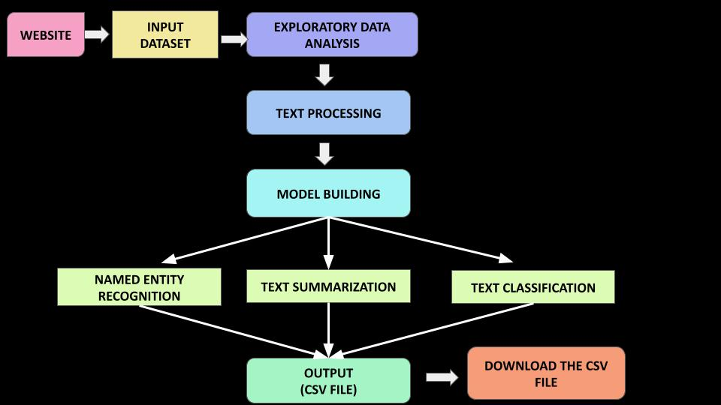
SCHEMATIC DIAGRAM

Slide 9
METHODOLOGY
In this part, we begin with loading the dataset file in csv format in the webpage.
We explore the selected text column using various exploratory data analysis techniques.
Then, we perform text processing like data cleaning , lexical analysis (tokenization, stop word removal, stemming, etc.,), followed by sentence level analysis (semantic, syntactic, pragmatic, and disclosure analysis).
After finishing the textual analysis, we perform Feature extraction where we extract useful features from the processed data.

Slide 10
METHODOLOGY
Then, you can select a model for building out of given 3 models:
Named – Entity Recognition
Text Summarization
Text Classification
For model building we use Transformers , a type of neural network architecture that uses encoders and decoders with positional embeddings to process the language.
They have been shown to outperform recurrent neural networks (RNNs) on a variety of natural language processing (NLP) tasks, such as text classification, machine translation, question answering, and text generation
They have ability to capture long term dependencies in text and process the text parallelly
This section concludes with the creation of a user-friendly web-based interface that generates the desired output.

Slide 11
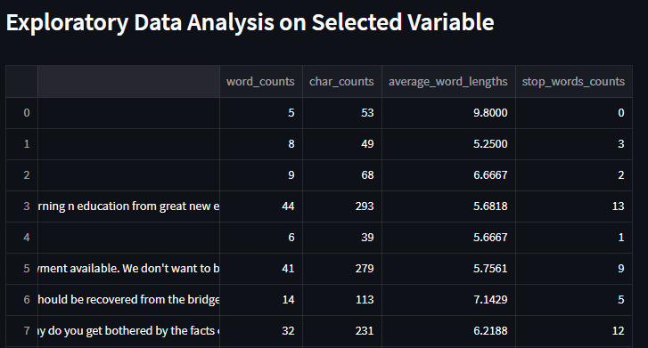
Result

Slide 12
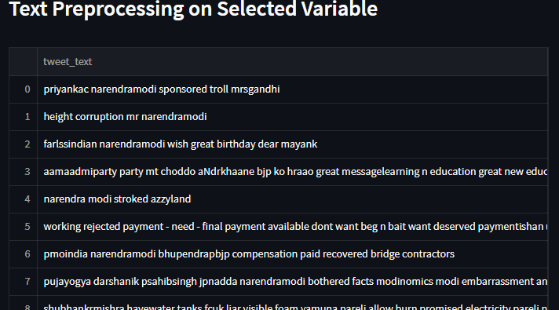
Result

Slide 13
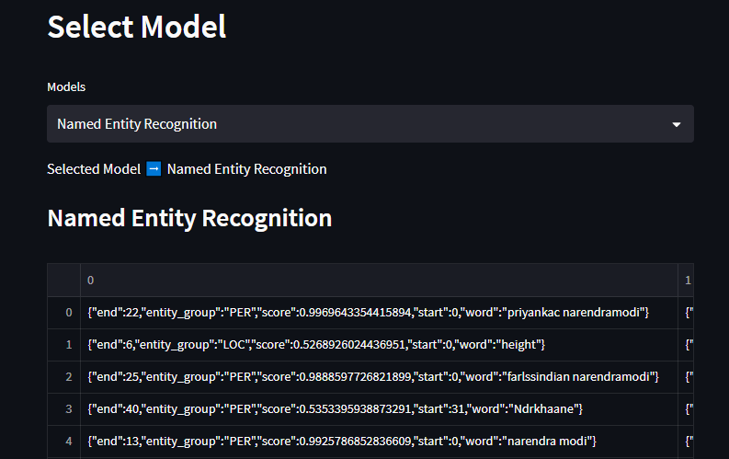
Result

Slide 14
SOFTWARE REQUIREMENTS
Operating System : Windows / Linux / Mac
IDE : Jupyter Notebook
Streamlit for Website
HARDWARE REQUIREMENTS
Ram 2GB+
Rom 10GB+
Intel i3 or better processor

Slide 15
Automation of natural language processing is an ongoing process that is becoming increasingly important as businesses strive to become more efficient and productive.
By automating natural language processing tasks, individuals and businesses can save time and resources while still delivering accurate results.
Automation helps to reduce the cost of human labor while improving the quality of results.
With the help of Web-based interface one can effectively use automation to streamline their natural language processing tasks and improve the accuracy of their results.
Conclusion

Slide 16
REFERENCES
[1] Manjusha Pandey Indrashis Das Siddharth S. Rautaray​ bharat sharma - “An Examination System Automation Using Natural Language Processing” - 2020
https://www.researchgate.net/publication/339406698_An_Examination_System_Automation_Using_Natural_Language_Processing​
[2] Ayisha Tabassum, Dr. Rajendra R. Patil - “A Survey on Text Pre-Processing & Feature Extraction Techniques in Natural Language Processing” - 2020
https://www.irjet.net/archives/V7/i6/IRJET-V7I6913.pdf
[3] Eftim Zdravevski, Petre Lameski, Vladimir Trajkovik, Ivan Chorbev, Rossitza Goleva, Nuno Pombo & Nuno M. Garcia - “Automation in Systematic, Scoping and Rapid Reviews by an NLP Toolkit: A Case Study in Enhanced Living Environments” - 2019
https://link.springer.com/chapter/10.1007/978-3-030-10752-9_1#Sec9​
[4] Mohammad Hossein ,Hassan B. Kazemian, Karim Ouazzane, Chris Chandler - “Natural Language Processing approach to NLP Meta model automation” - 2018
http://repository.londonmet.ac.uk/3447/1/Paper.pdf

